Slide 1
Sales Dashboard Analysis
By Riya

Slide 2
Objective
To analyze business performance based on sales, profit, and customer insights using Power BI, enabling data-driven decision-making.
Dataset Summary:
Source: Kaggle
Records: 1000+
Fields: Product_Category, Sales_Rep, Region, Customer_Type, Sales_Channel, etc.
Metrics used: Sales_Amount, Quantity_Sold, Profit, Unit_Price, Unit_Cost

Slide 3
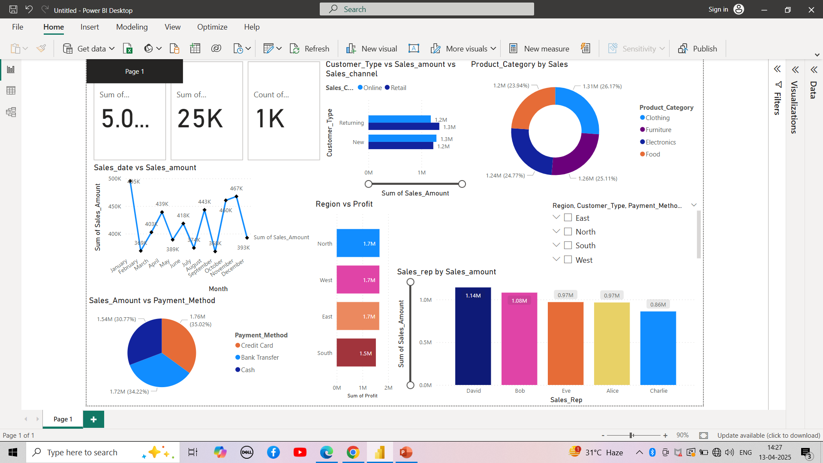
Dashboard Overview

Slide 4
Dashboard Highlights
KPIs: Total Sales, Profit, Quantity Sold, Orders
Filters: Region, Sales Rep, Product Category, Customer Type
Visuals: Line chart, bar chart, donut chart, slicers

Slide 5
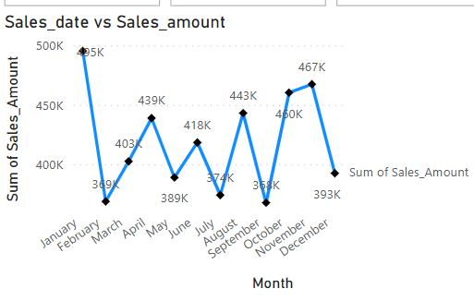
Line Chart – Sales Trend Over Time Insight: Sales peak in November, showing a seasonal spike—possibly due to holidays or end-of-year demand.

Slide 6
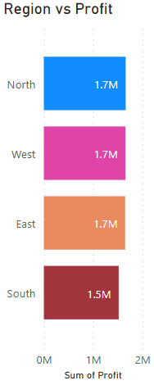
Bar Chart – Profit by Region Insight: The North region contributes the most to overall profit. South has lower profitability—possibly needing sales support or promotions.

Slide 7
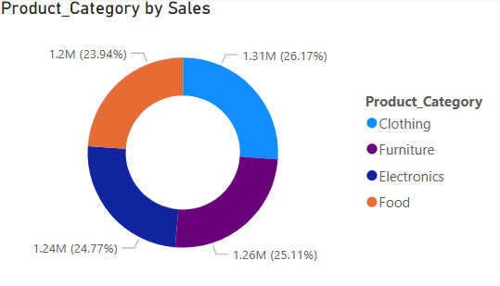
Donut Chart – Sales by Product Category Insight: Clothing and Electronics dominate sales, indicating popular product lines. Other categories contribute less.

Slide 8
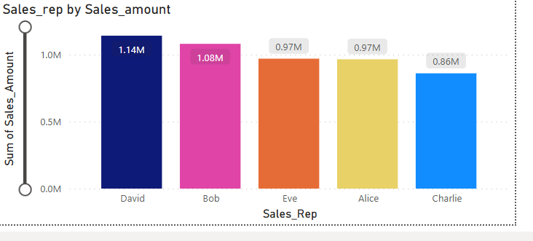
Stacked Column Chart – Sales_amount by Sales Rep
Insight: David and Bob are top performers in terms of total sales and profit. Investing in their sales strategies might increase revenue.

Slide 9
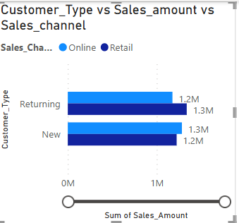
Clustered Bar – Customer Type vs. Sales Insight: New customers slightly outperform returning customers, but both contribute significantly—highlighting the importance of loyalty programs.

Slide 10
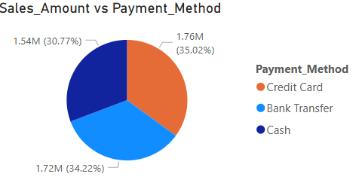
Pie Chart – Payment Method Popularity Insight: Credit Card is the most frequently used method, followed by Cash and Debit Cards—useful for optimizing payment processing.

Slide 11
THANKYOU

